Slide 1



EV Charging Demand Prediction
NAME: SHAIKH SAAIEM SALAAR MOHAMMED SALEEM
STUDENT ID: 221846
AICTE Internship Student Registration ID: STU682185dbe99e81747027419

Slide 2

Learning Objectives
Understand trends in Electric Vehicle (EV) adoption
Use historical EV registration data to forecast future demand
Build a machine learning-based forecasting tool
Deploy an interactive prediction web-app for public use
GOAL
Source :
www.freepik.com/

Slide 3






Tools and Technology used
Language: Python
Libraries: Pandas, NumPy, Scikit-learn, Matplotlib
Framework: Streamlit
Model: Forecasting using custom lag features + Gradient Boosting
Deployment: Streamlit app interface

Slide 4
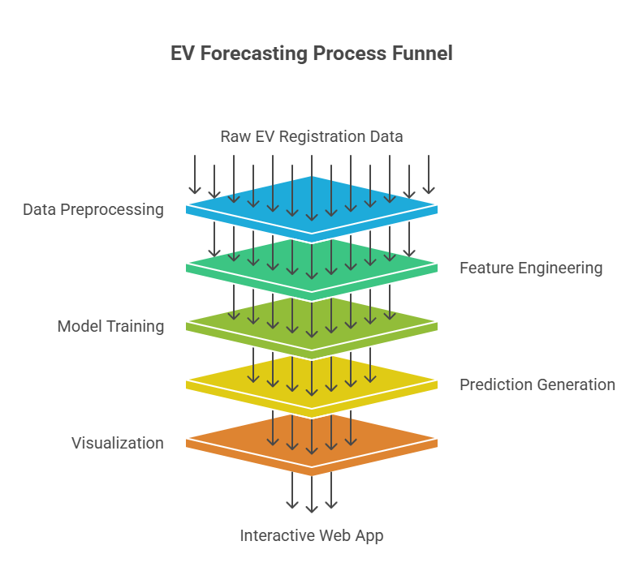
Methodology
Preprocess and clean EV registration data
Engineer features using rolling means, lags, growth rates
Train forecasting model using county-level trends
Predict EV totals for next 36 months
Visualize cumulative growth
Deploy via interactive web app

Slide 5
Problem Statement:
With the global push towards cleaner energy and sustainable transportation, the demand for electric vehicles (EVs) is rapidly increasing. However, predicting this demand accurately is a complex task influenced by multiple dynamic factors such as fuel prices, government policies, environmental awareness, technological advancements, urbanization trends, and consumer behavior.
This project aims to develop a data-driven predictive model that can analyze historical and real-time datasets, such as vehicle registration records, population growth, income levels, fuel costs, policy incentives, and market trends, to forecast the future demand for electric vehicles in different regions or market segments.
The goal is to assist policymakers, automotive manufacturers, and infrastructure planners in making informed decisions regarding EV production, charging infrastructure deployment, supply chain adjustments, and sustainability strategies. By leveraging machine learning algorithms and data analytics, the project seeks to turn raw data into actionable insights for smarter planning and investment in the EV ecosystem.

Slide 6
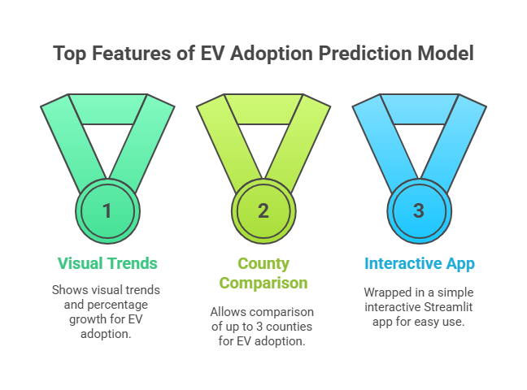

Solution:
We built a machine learning model that:
Takes in historical monthly EV registrations by county
Predicts future EV adoption for 3 years
Shows visual trends and percentage growth
Allows comparison of up to 3 counties
All of this is wrapped in a simple interactive Streamlit app.
GITHUB REPO: https://github.com/Salaar-Saaiem/EV-Adoption-Forecasting.git

Slide 7
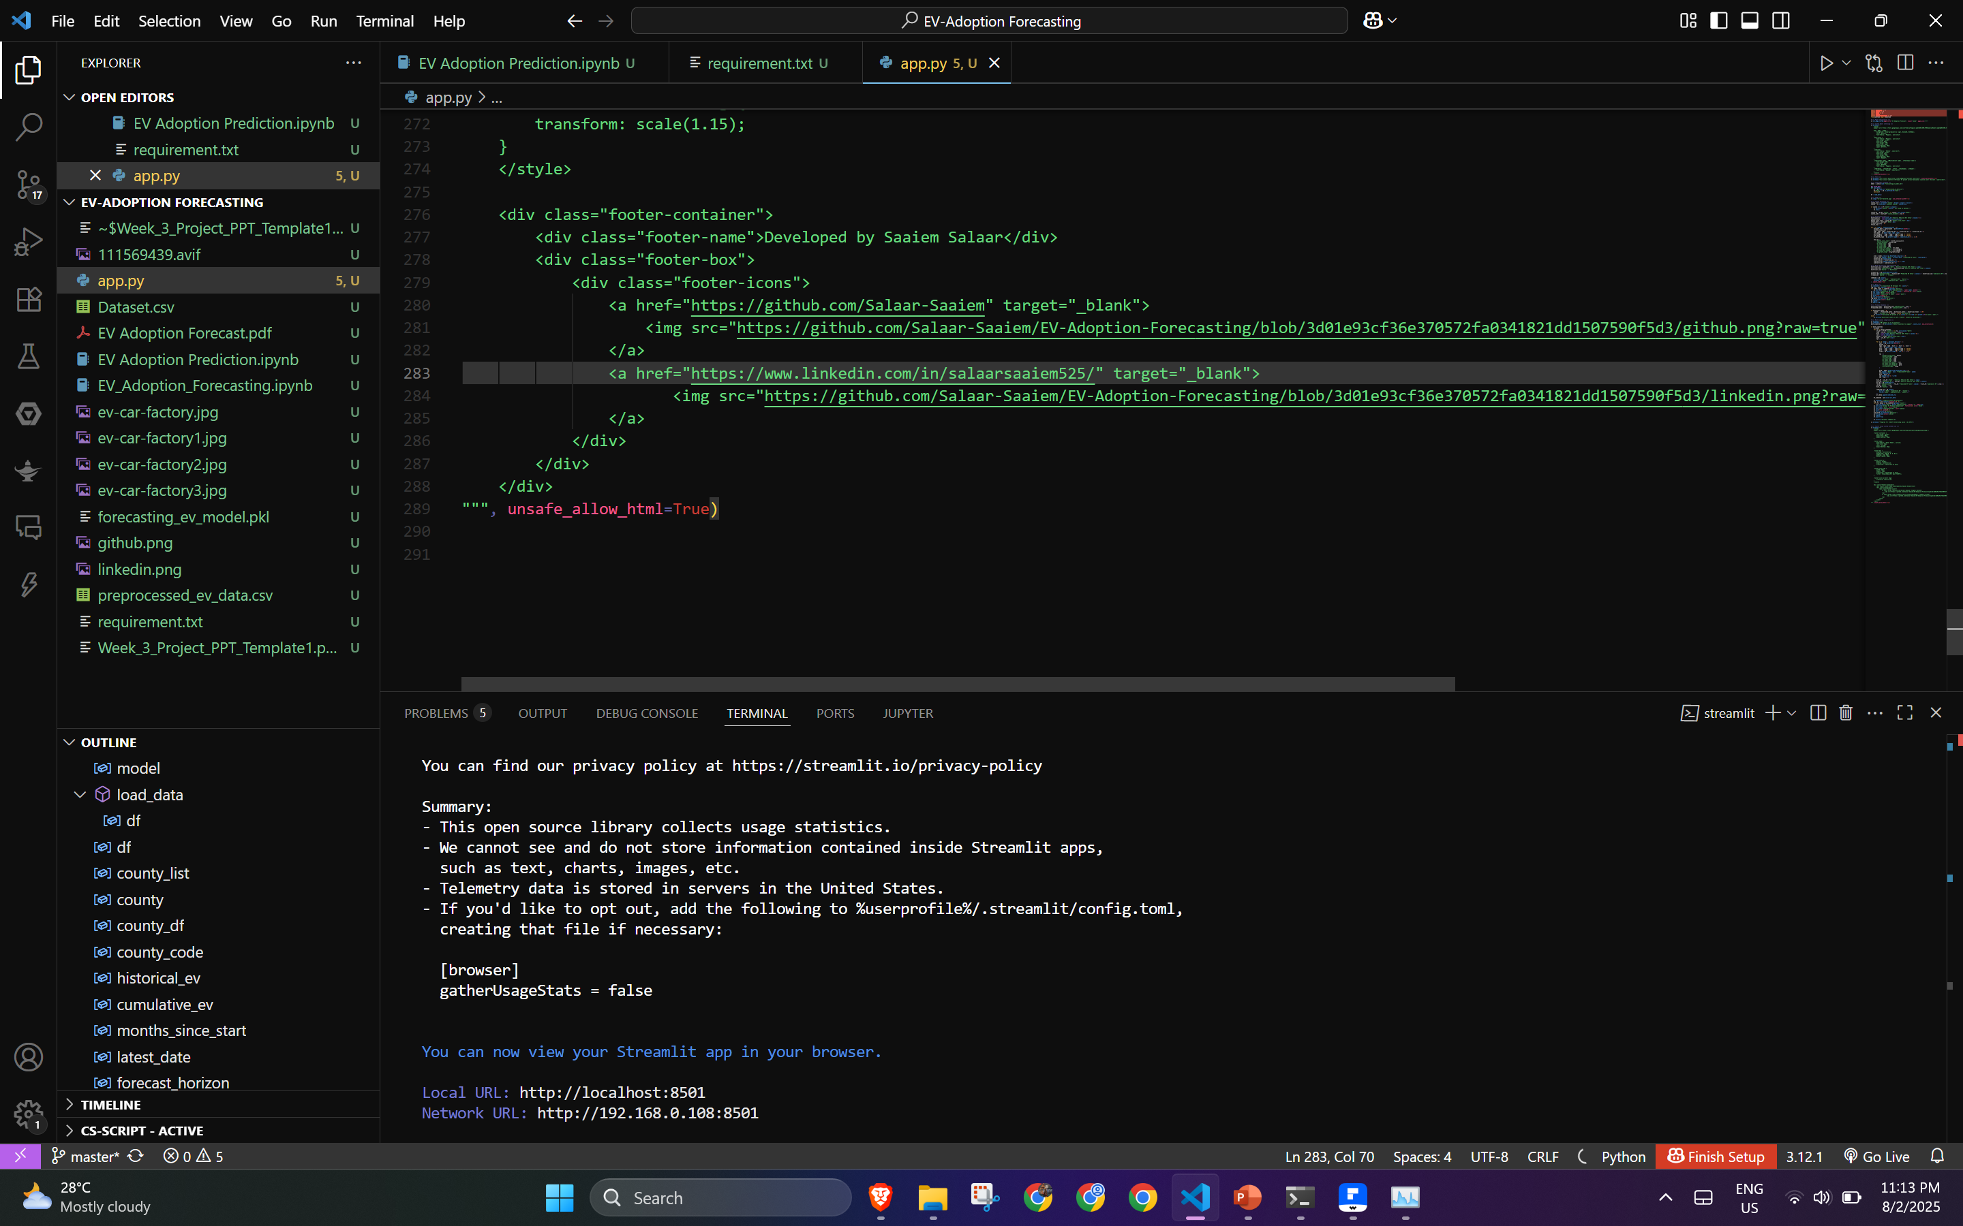
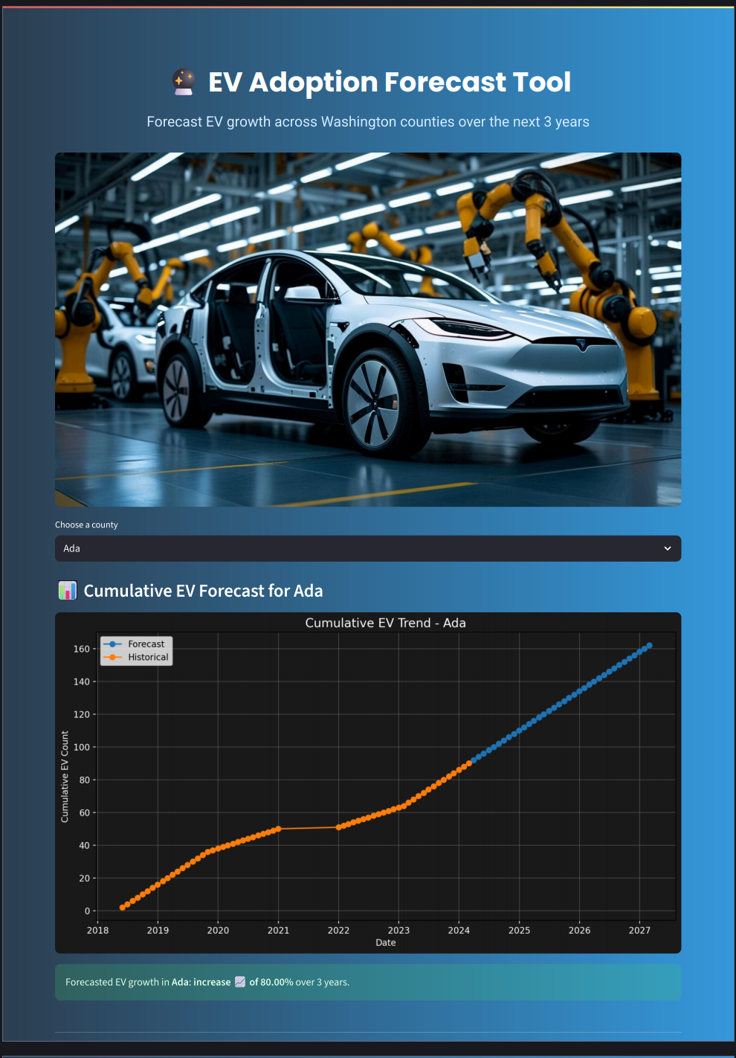
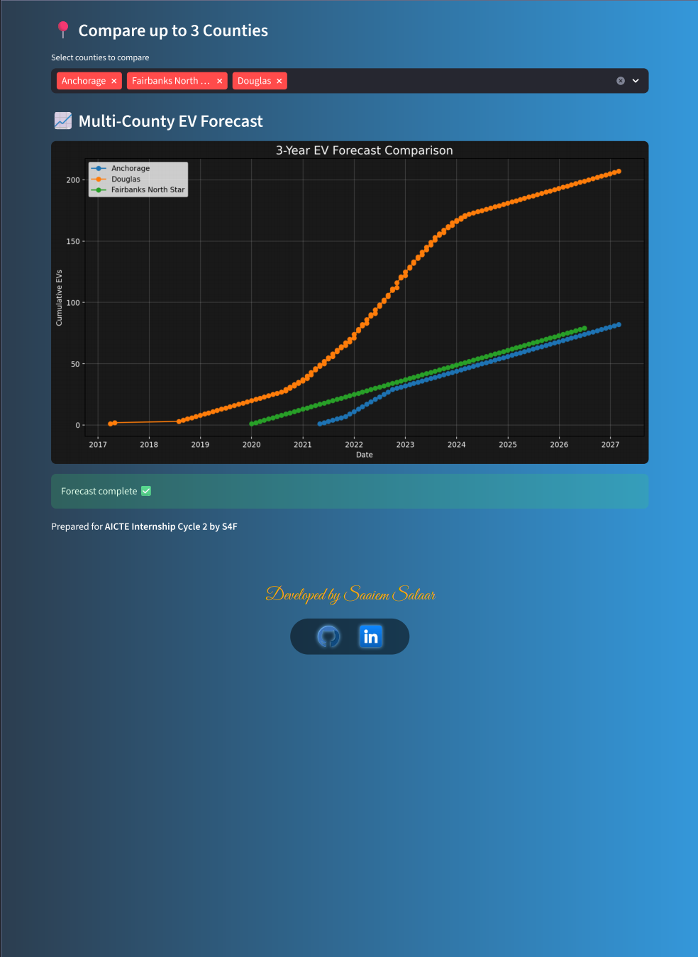
Screenshot of Output:

Slide 8
Conclusion:
This project developed a machine learning-based tool to forecast EV adoption across Washington counties using historical registration data. By engineering trend-based features and deploying a user-friendly Streamlit app, we enabled 3-year EV growth predictions and multi-county comparisons. This helps stakeholders plan charging infrastructure and energy needs more effectively.
Future Scope:
Integrate real-time data for live forecasting
Add features like fuel cost, incentives, and population growth
Expand to state/national scale
Predict charging station demand
Explore deep learning (LSTM, hybrid models)
Add geospatial heatmaps and mobile/API access

Slide 9


THANK YOU
DEVELOPED BY:
SAAIEM SALAAR
Github
LinkedIn

